Slide 1
CSML1010 – Final Project
Group 11 – Alex Fung and Patrick Osborne
Instructor – Dr. En-Shiun Annie Lee

Slide 2

Twitter US Airline – Sentiment Analysis
Dataset from Twitter
14,640 thousand tweets
15 Features
6 US Airlines
Positive | Neutral | Negative
Aligns with a business problem
How to stop negative tweet trends before they go out of control?
Identify the early tweets accurately -> Sentiment Analysis!
Presents an interesting ML/Data challenge
Data is messy (Twitter character limit, slang, emojis, @ and #)

Slide 3
Sentiment Analysis

Slide 4

Existing Work - Academia
“Sentiment Analysis of Twitter Feeds” - Yogesh Garg, Niladri Chatterjee
https://link.springer.com/chapter/10.1007/978-3-319-13820-6_3
Similar angle for Tweet Sentiment classification -> intended for use in business context
Similar problems in parsing slang/unique features

Slide 5



Existing Work - Industry
Existing Software Products providing Twitter Sentiment Analysis:
NCSU Tweet Sentiment Visualization App Software
https://www.csc2.ncsu.edu/faculty/healey/tweet_viz
Mention
https://mention.com
Social Searcher
https://www.social-searcher.com/
Many others available – some integrated into CRMs/other marketing software

Slide 6
Twitter US Airline – Sentiment Analysis
Dataset from Twitter
14,640 thousand tweets
15 Features
6 US Airlines
Positive | Neutral | Negative
Aligns with a business problem
How to stop negative tweet trends before they go out of control?
Identify the early tweets accurately -> Sentiment Analysis!
Presents an interesting ML/Data challenge
Data is messy (Twitter character limit, slang, emojis, @ and #)

Slide 7
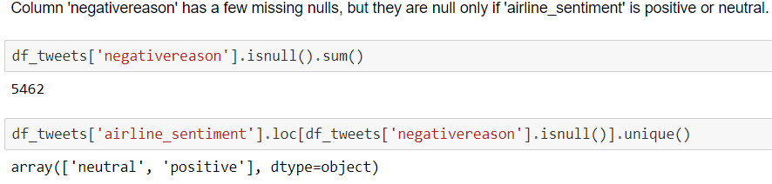
Loading Data
Loading Data
Available as CSV and SQL
UTF-8 encoding to preserve emojis 👍
Check for NULL Values

Slide 8


Cleaning Data
Twitter data notoriously unclean
Character limit forces non-standard English
Remove noise for sentiment analysis
@ Mentions, RT re-tweets
Retain value-adds
Emojis 💻, hashtags #
Add important context and content
Clean text itself
Remove HTML, translate slang, remove STOP words and grammar, lemmatize

Slide 9
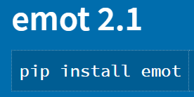
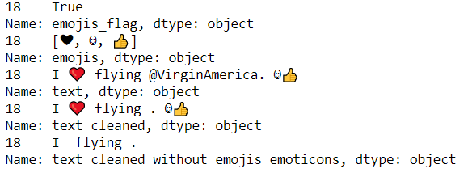
Data Cleaning Challenges
How to extract emojis?

Slide 10
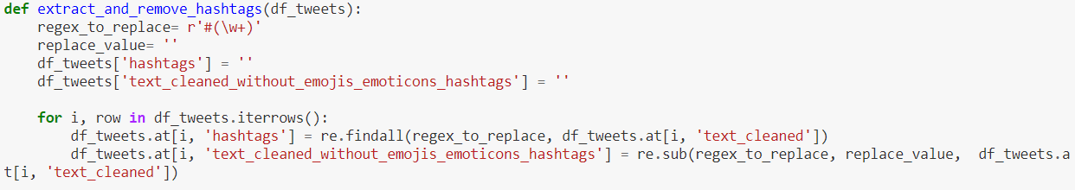
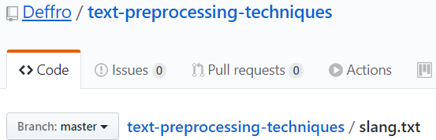
Data Cleaning Challenges
Extract Hashtags?
Text to lowercase
Convert Slang
Find and replace based on an existing dictionary

Slide 11

Text Cleaning
Remove stop words
“The”, “and”, “You”, etc. -> noise
Remove punctuation & numbers
Lemmatize
Tokenize

Slide 12
Data Exploration
15 columns
6 main features that interest us
airline_sentiment
airline_sentiment confidence
negativereason
negativereason_confidence
airline
text
Engineered Features
emojis
emoticons
cleaned text (lemmas)

Slide 13
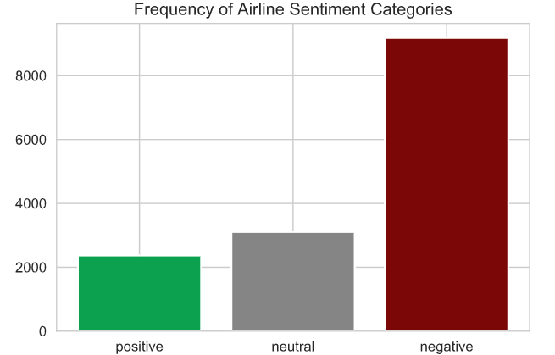
Data Exploration

Slide 14
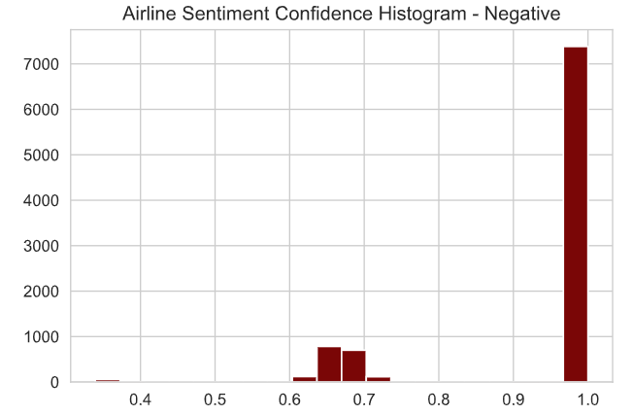
Data Exploration

Slide 15
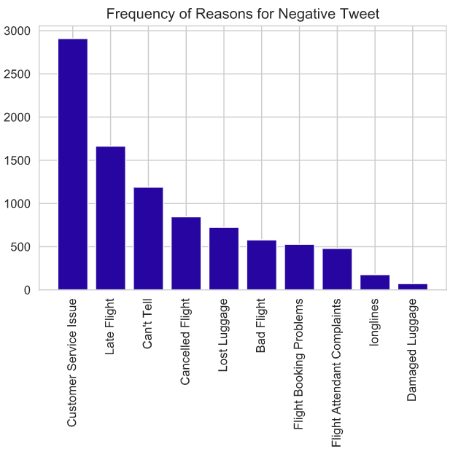
Data Exploration

Slide 16
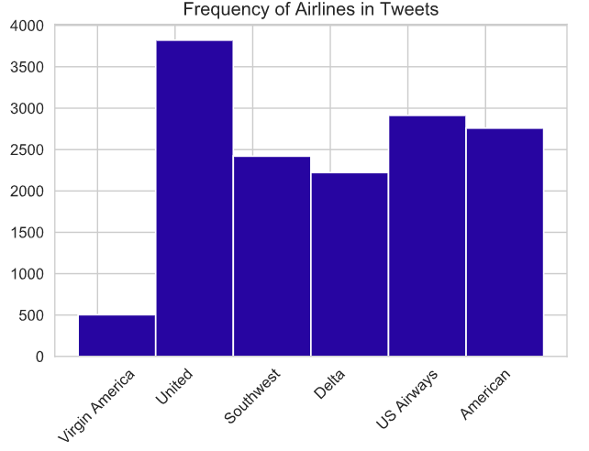
Data Exploration

Slide 17
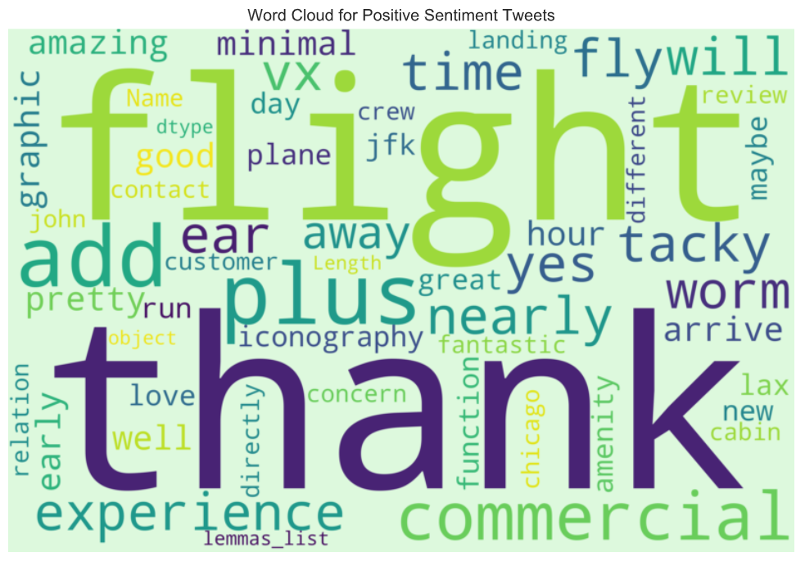
Data Exploration

Slide 18
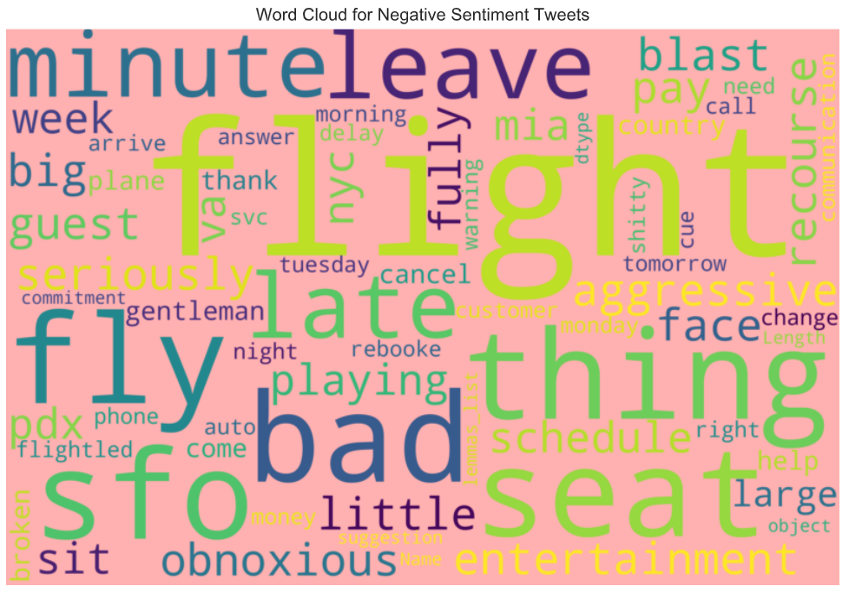
Data Exploration

Slide 19
Data Exploration – Emojis & Hashtags
Is there value in the extracted emojis and hashtags?
Method:
Plot frequency by sentiment class (positive, neutral, negative)
If there is a clear difference – emojis & hashtags are differentiators -> add context

Slide 20
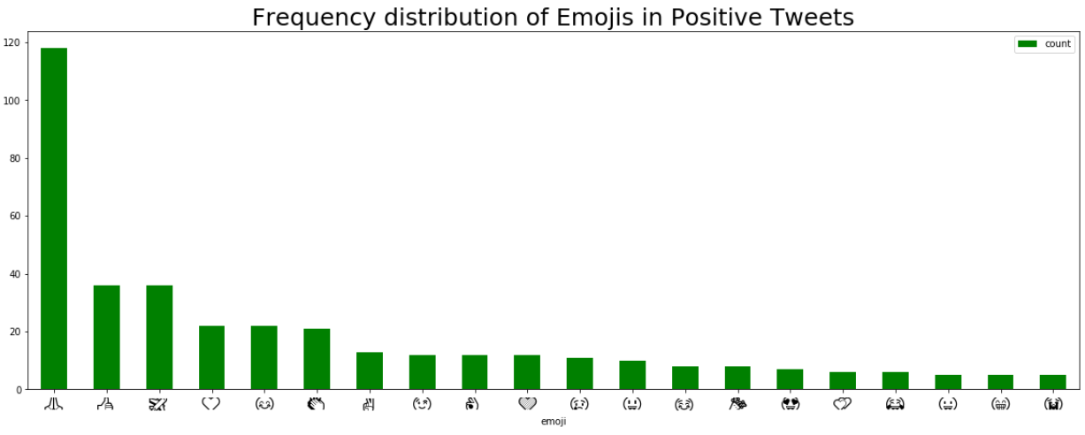
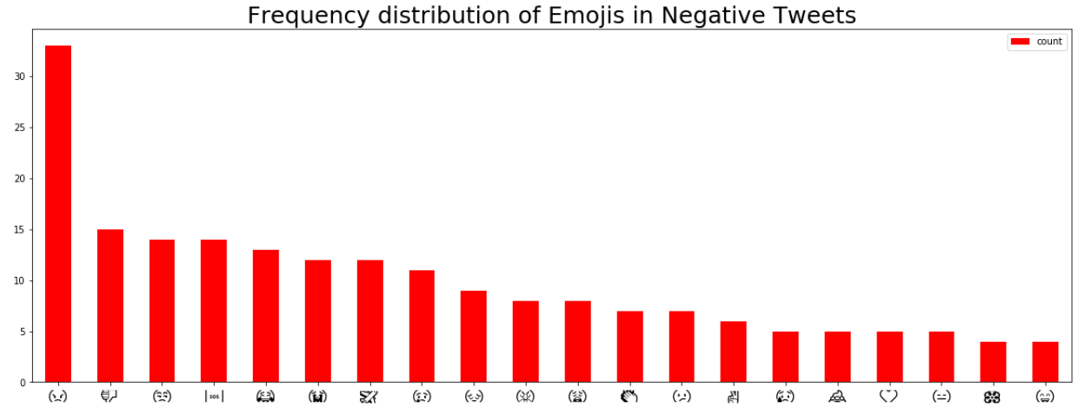

Slide 21
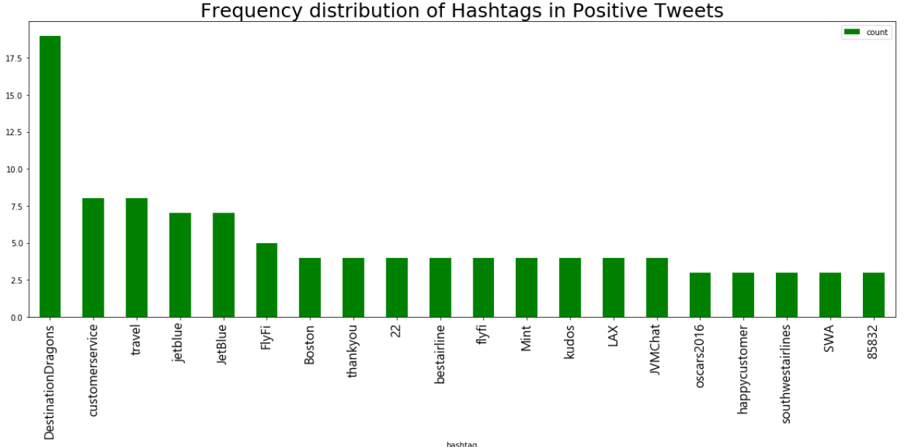
Data Exploration – Emojis & Hashtags

Slide 22
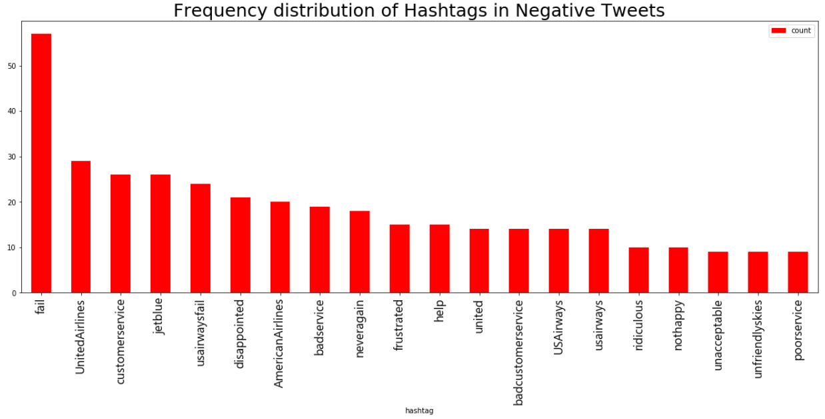
Data Exploration – Emojis & Hashtags

Slide 23
Data Exploration – Emojis & Hashtags
Issues with our emoji, emoticon and hashtag extraction
Extraction process confuses non-emoticon string of characters for an emoticon
E.g. time of day, airport codes
Hashtags could be cleaned further
Reduce to lowercase, remove stop words, lemmatize
Challenging as hashtags are not pure English

Slide 24
CSML1010 – Milestone 1
Group 11 – Alex Fung and Patrick Osborne
Instructor – Dr. En-Shiun Annie Lee

Slide 25

Twitter US Airline – Sentiment Analysis
Milestone 1
Feature Engineering
Feature Selection
Benchmarking
Feature Engineering
Idea is to pull as much information out of the text as we can
Various ways of parsing and interpreting the text
Feature Selection
Too many features – will overwhelm our model. Need to keep the best and discard the rest

Slide 26
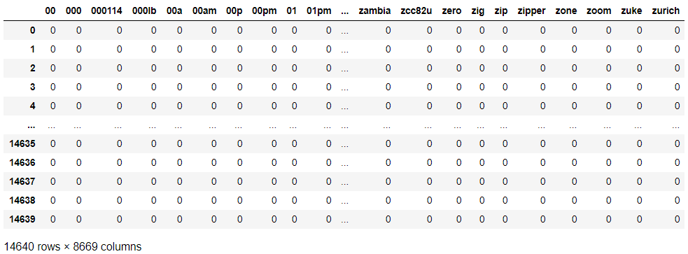

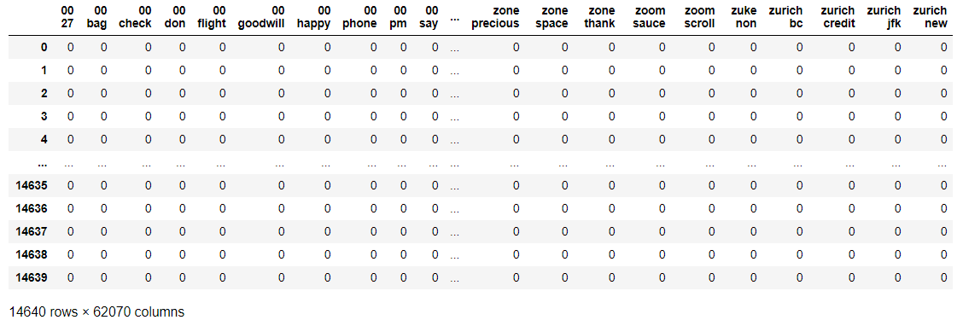
Feature Engineering – Basic Methods
Bag of Words
Bag of N-Grams

Slide 27
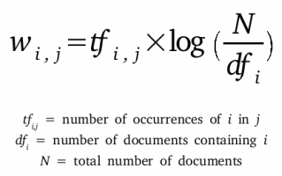
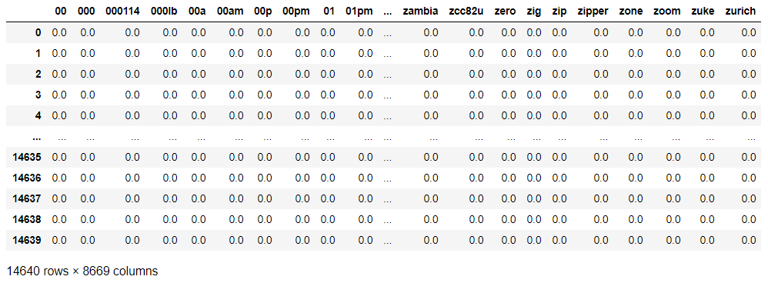
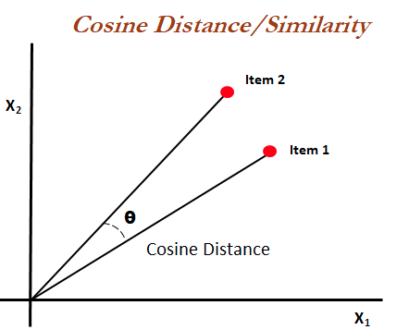
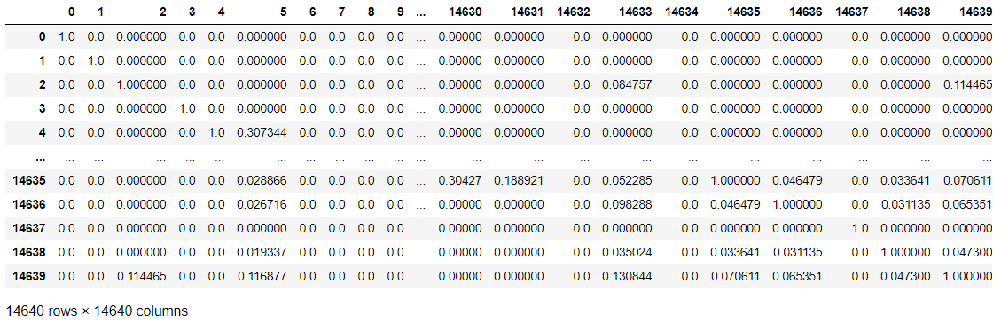
Feature Engineering – Basic Methods
TF-IDF
Cosine Similarity

Slide 28
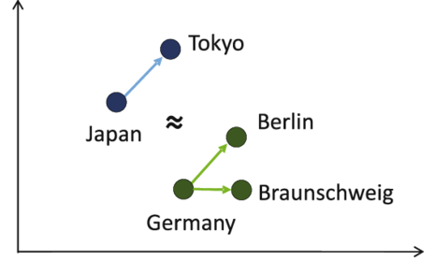
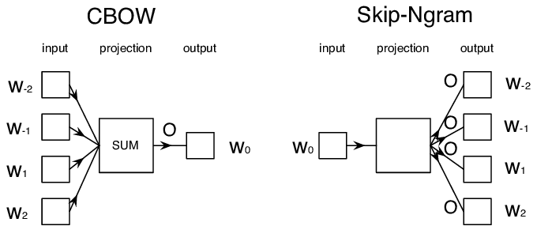
Feature Engineering – Word2Vec
Word2Vec
A form of word embedding
Represent individual words in a way that
similar words are represented in similar
ways
Generates numerical vectors
CBOW vs Skip-gram
Frequency/speed/accuracy trade-offs

Slide 29



Feature Engineering – Word2Vec - Models
Tensorflow / Keras Trained
Manual process
Slow even when GPU accelerated
Gensim Trained
Very fast
Possibly less fine-grained control
Google Pre-Trained
Fastest
Advantage of training on existing corpus
Cannot custom train to our dataset

Slide 30

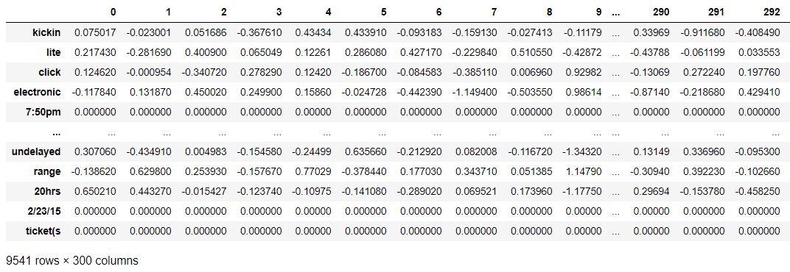
Feature Engineering – GloVe
GloVe Word Embedding
Global Vectors for Word Representation
An alternate model

Slide 31
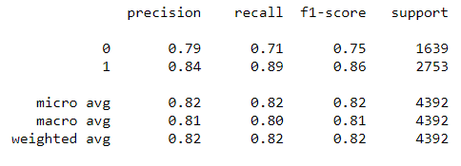
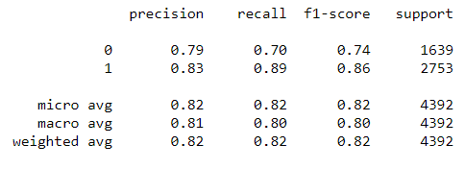
Benchmarking – Logistic Regression
Gensim Word2Vec Word Embeddings
Google Word2Vec Pre-Trained Word Embeddings

Slide 32
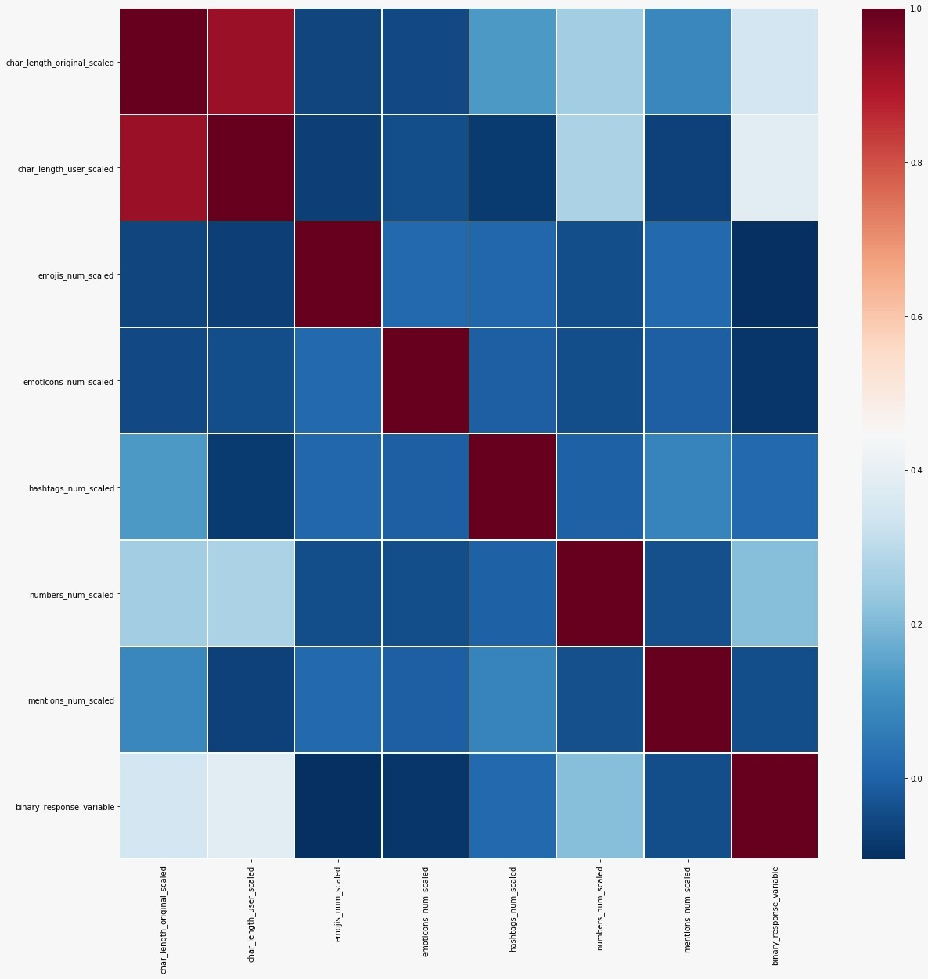
Feature Selection
Correlation Matrix
of
Engineered Features

Slide 33
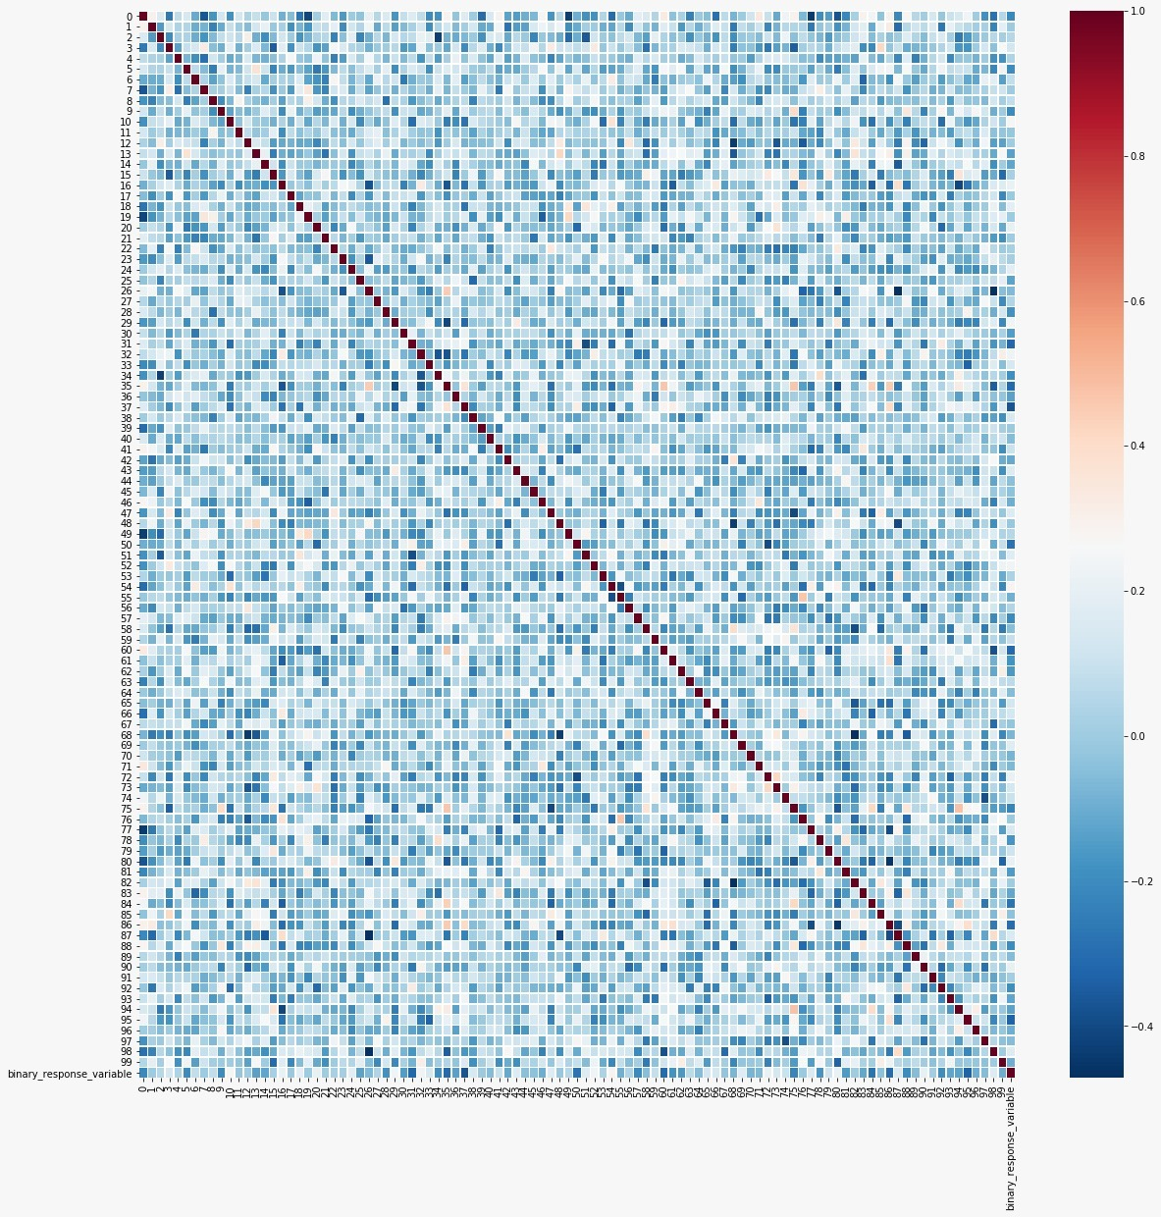
Feature Selection
Correlation Matrix
of
Gensim word2vec

Slide 34
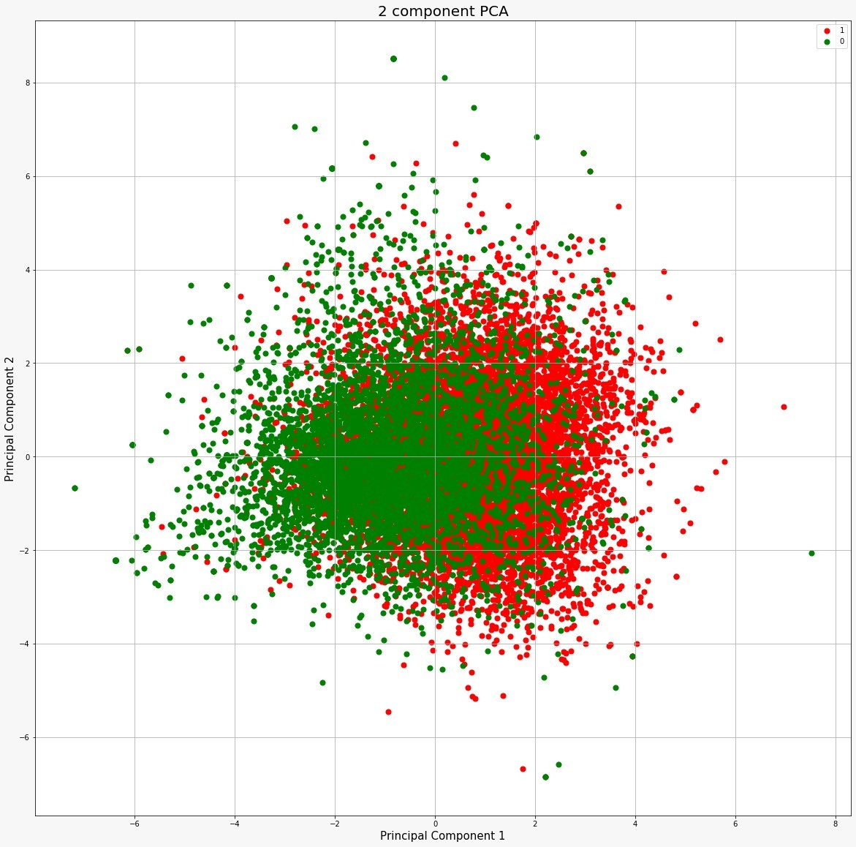
Principal
Component
Analysis
(Dimensionality
Reduction)

Slide 35
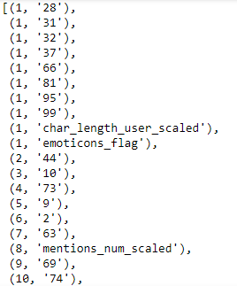
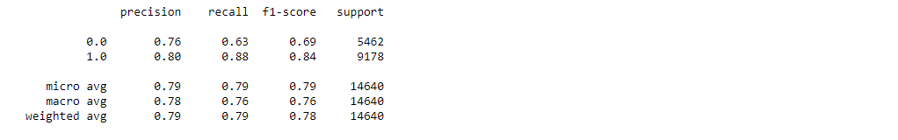
Feature Selection
Top 10 Features Ranked
Recursive
Feature
Elimination
Benchmark Results

Slide 36
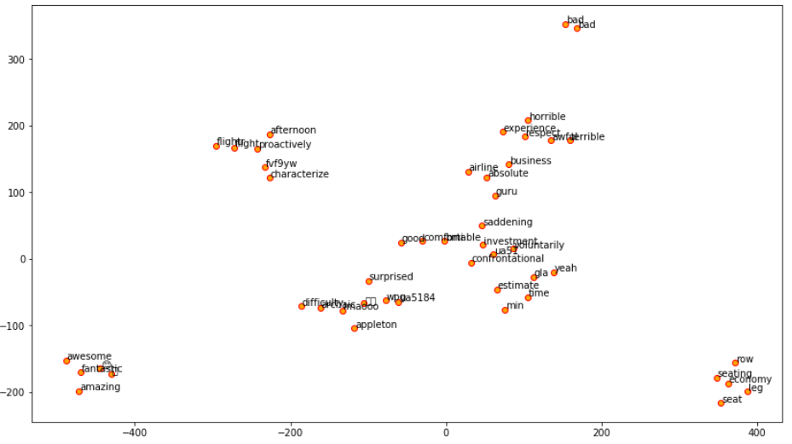
Feature Exploration
Gensim Word2Vec

Slide 37
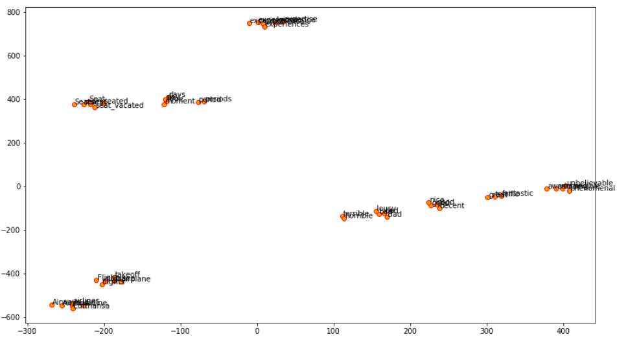
Feature Exploration
Google Word2Vec

Slide 38
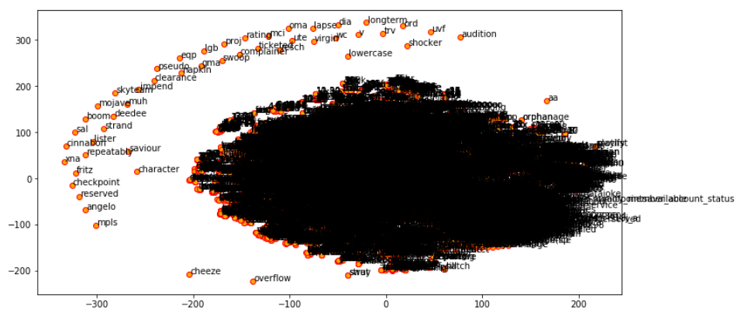
Feature Exploration
GloVe
All word embeddings

Slide 39
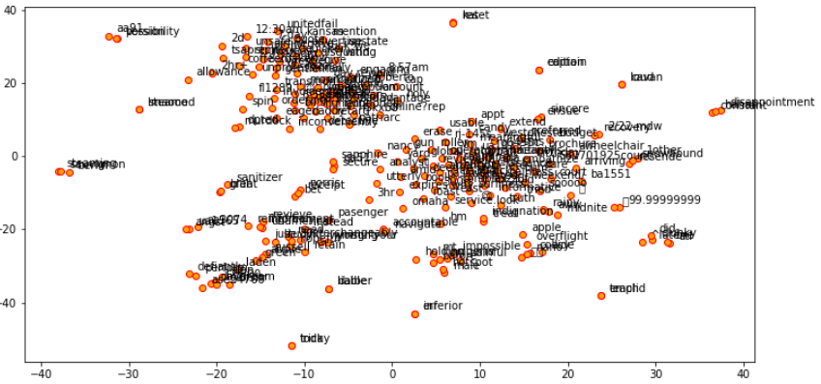
Feature Exploration
GloVe
250 item sample

Slide 40
CSML1010 – Milestone 2
Group 11 – Alex Fung and Patrick Osborne
Instructor – Dr. En-Shiun Annie Lee

Slide 41


Twitter US Airline – Sentiment Analysis
Milestone 2
Model Benchmarking
Hyperparameter Optimization
Ensemble Methods
Analysis and Model Selection

Slide 42

Twitter US Airline – Sentiment Analysis
Combined Feature Engineered Dataset
Data is fully numerical now
Engineered Features
E.g. Emojis/Emoticons
Hashtags
Etc.
GloVe Word Embeddings
(300 dimension)
Binary response variable

Slide 43


Model Benchmarking – Supervised Learning
Supervised Models (Classification)
K Nearest Neighbors
Decision Tree
Support Vector Classifier
Gaussian Naïve Bayes
Logistic Regression

Slide 44
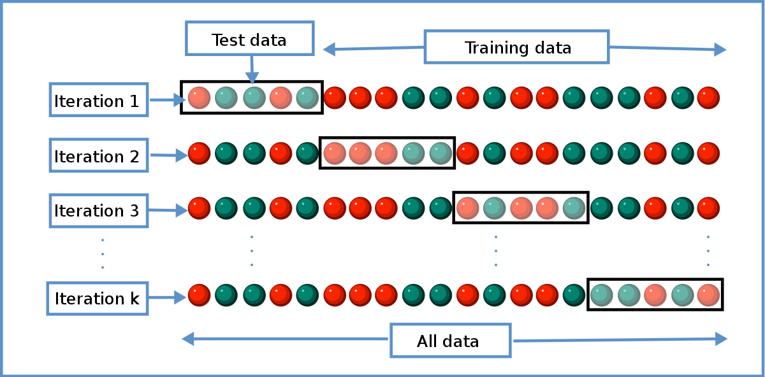
Model Benchmarking - Execution
Stratified K-fold Cross Validation
Using sklearn
Various Scorers:
Fit time, Score time, Bal. Accuracy, F1 score, F2 score, Precision, Recall, ROC-AUC

Slide 45
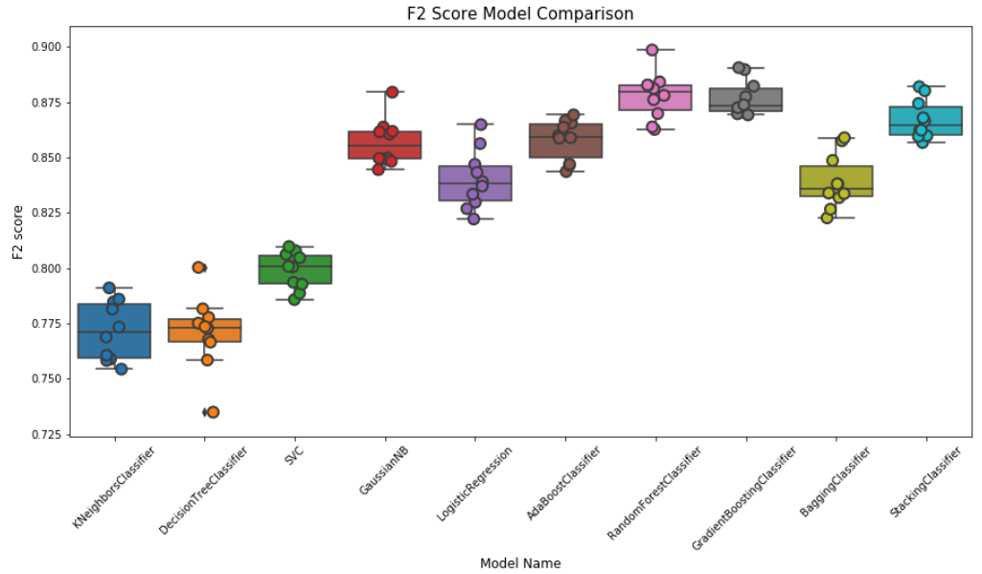
Model Benchmarking – F2 Score

Slide 46
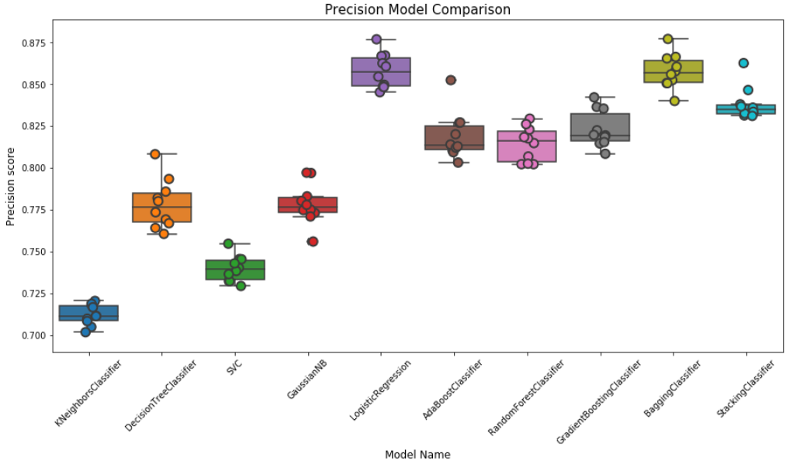
Model Benchmarking – Precision

Slide 47
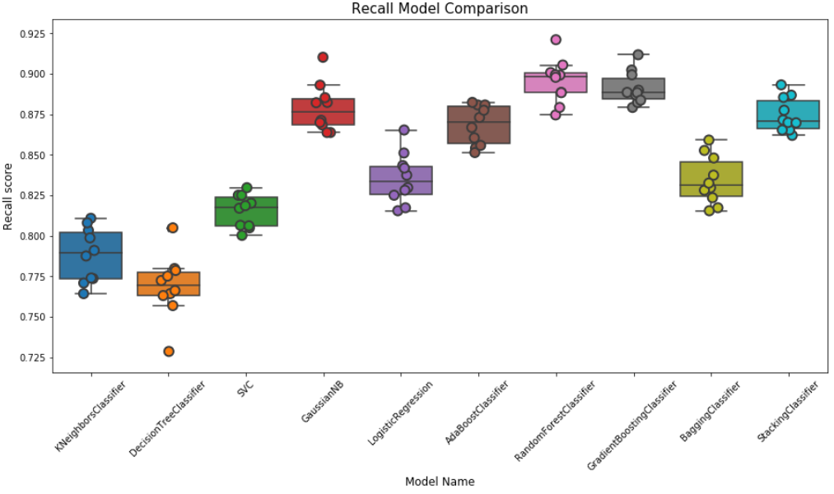
Model Benchmarking – Recall

Slide 48
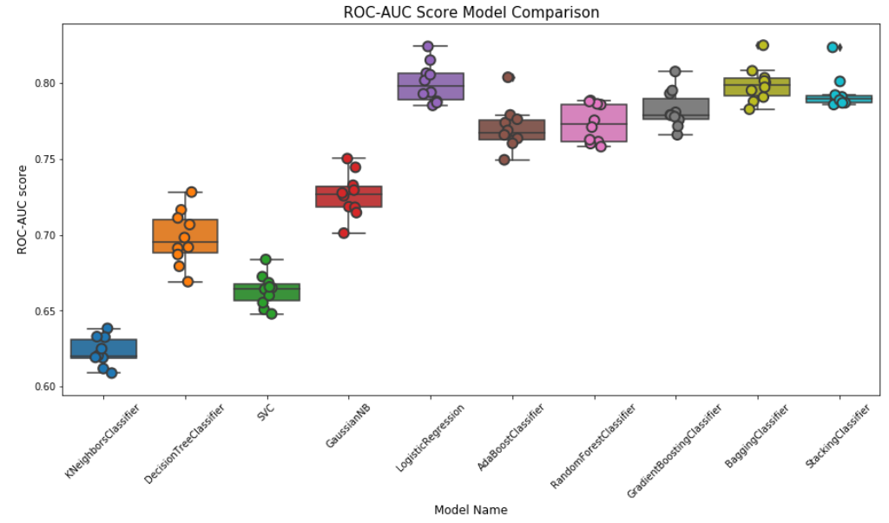
Model Benchmarking – ROC-AUC

Slide 49
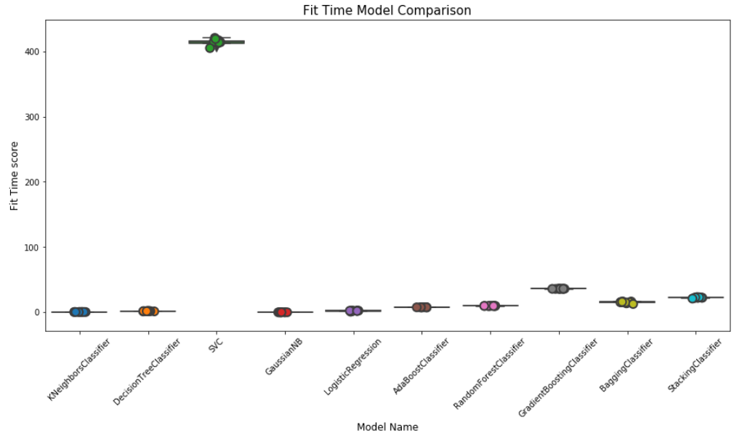
Model Benchmarking – Fit Time

Slide 50
Hyperparameter Optimization
Grid Search
Exhaustive test of parameters from a specified list
Time consuming, but certain to provide the best set of parameters
Random Search
Random search of provide parameters
Faster but could possibly miss some combinations of parameters

Slide 51
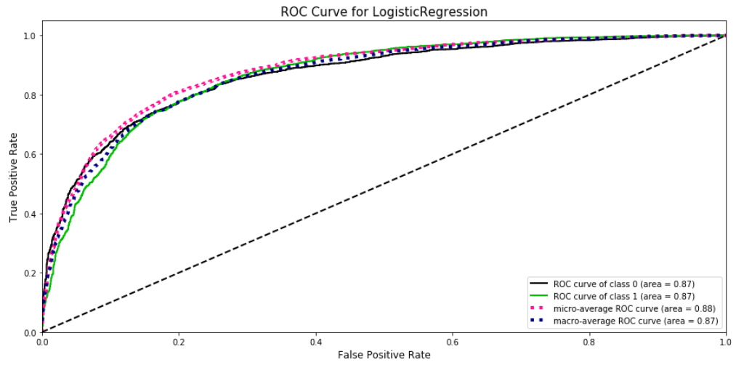
Hyperparameter Optimization
Logistic Regression – Pre-Optimization

Slide 52
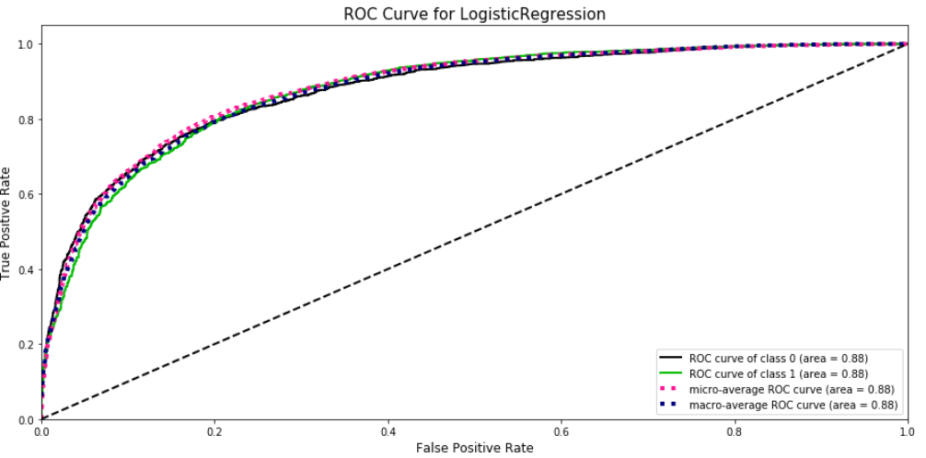
Hyperparameter Optimization
Logistic Regression – Post-Optimization

Slide 53
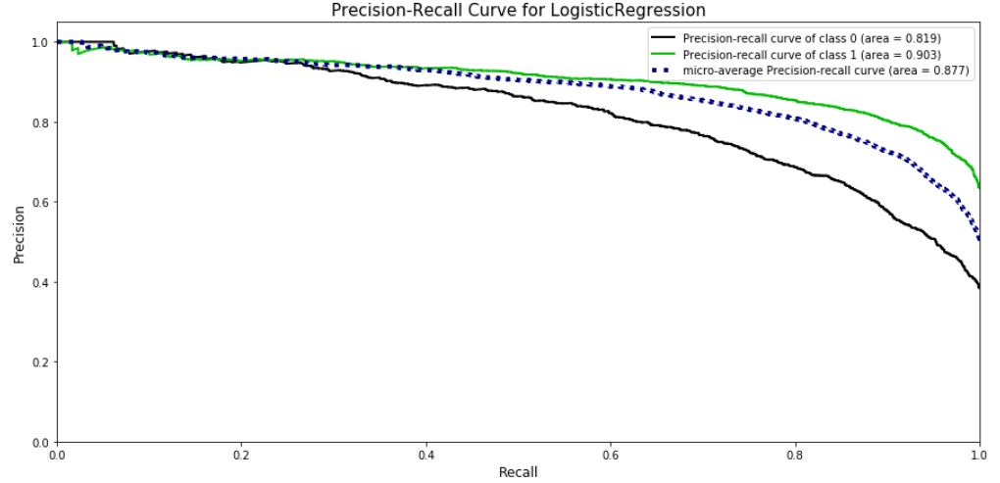
Hyperparameter Optimization
Logistic Regression – Pre-Optimization

Slide 54
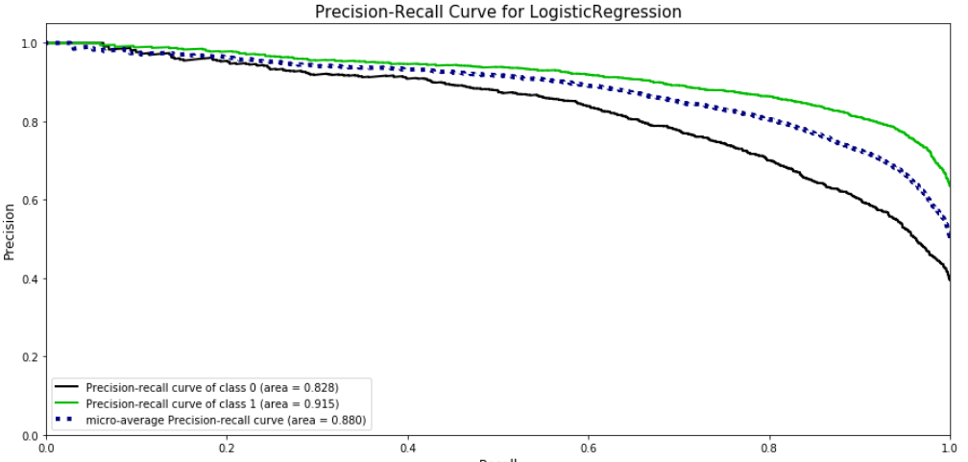
Hyperparameter Optimization
Logistic Regression – Post-Optimization

Slide 55
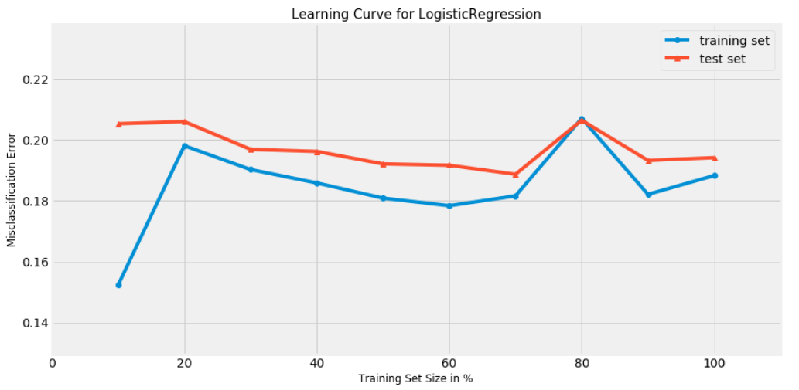
Hyperparameter Optimization
Logistic Regression – Pre-Optimization

Slide 56
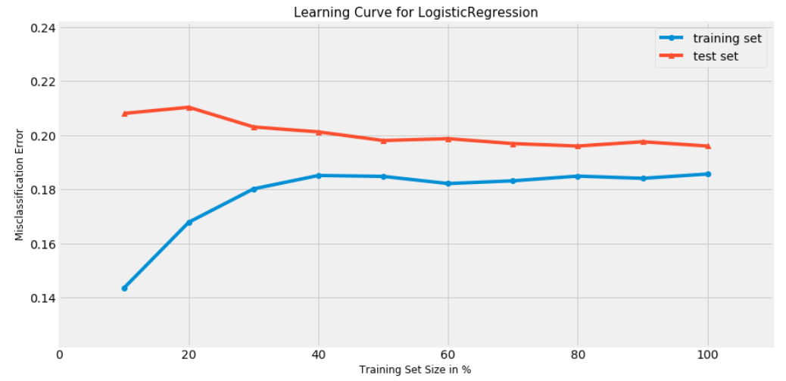
Hyperparameter Optimization
Logistic Regression – Post-Optimization

Slide 57
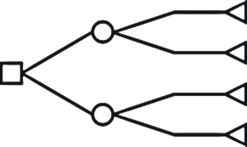
Ensemble Methods
Boosting
Gradient Boosting Machine
Ada Boost
Bagging
Random Forest
Bagging Classifier
Stacking
Stacking Classifier (sci-kit learn 0.22)

Slide 58
Model Selection
Using scores/metrics to select model
F2 score
Fit time (as this may need to be deployed)
Learning Curve
Precision-Recall Curve
Narrowed down list
Logistic Regression
Good fit time, good metrics - selected
Gradient Boosting Machine
Fit time and parameters too complex - rejected
Stacking
Good combination of base learners, fit time acceptable - selected

Slide 59
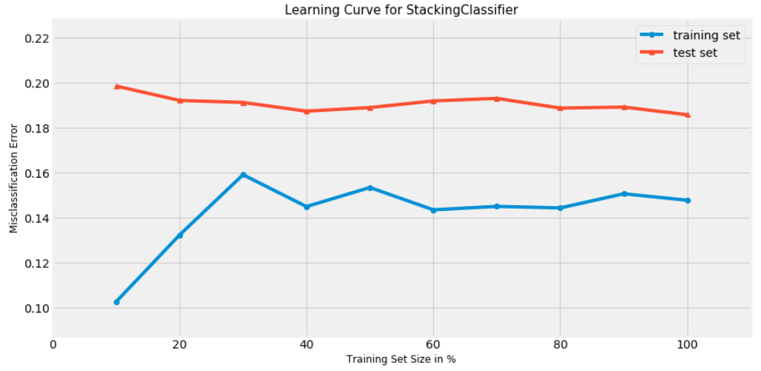
Model Selection – Learning Curve
Stacking Classifier

Slide 60
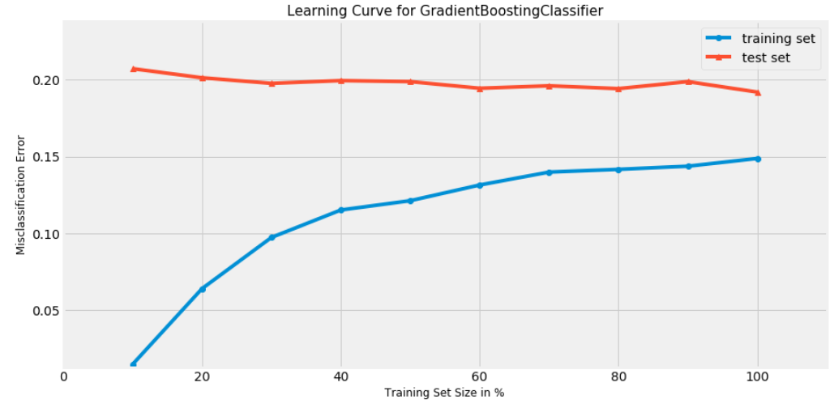
Model Selection – Learning Curve
Gradient Boosting Machine

Slide 61

Model Selection – Learning Curve
Logistic Regression

Slide 62






Model Interpretability – LIME
Negative
Positive
Neutral?

Slide 63
Thank You!

